Slide 1
GLP4NN: A Convergence-invariant and Network-agnostic Light-weight Parallelization Framework for Deep Neural Networks on Modern GPUs
Hao Fu, Shanjiang Tang
Tianjin University, China
Bingsheng He
National University of Singapore, Singapore
Ce Yu, Jizhou Sun
Tianjin University, China
haofu@tju.edu.cn
ICPP 2018
Eugene, Oregon, USA
Notes:
Good morning, everyone. I'm Hao Fu from Tianjin University. Today my topic is GLP4NN, which is a light-weight parallelization framework for deep neural networks on modern GPUs.

Slide 2
Overview -- Deep Neural Networks
Wide applications
obejct detection^{[MM'14]}, multi-modal data analysis^{[MM'14]}, natural language processing^{[EACL'17]}
Popular neural network architectures
Convolution Neural Networks^{[IJCV'15]}, Recurrent Neural Networks^{[INTERSPEECH'14]}
common layers in a CNN model: convolution layer, pooling layer, fully connected layer and loss layer
Overview of the CaffeNet model

Slide 3
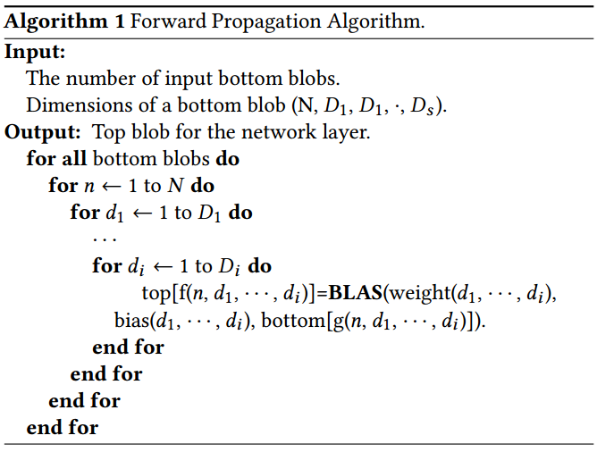
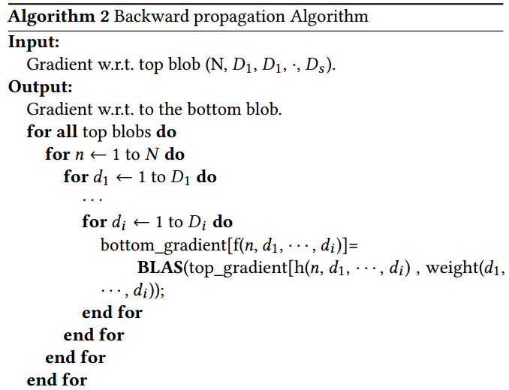
Overview -- Deep Neural Networks
Batch training method for DNN models
Forward propagation phase
Backward propagation phase
batch size
computation of one sample

Slide 4
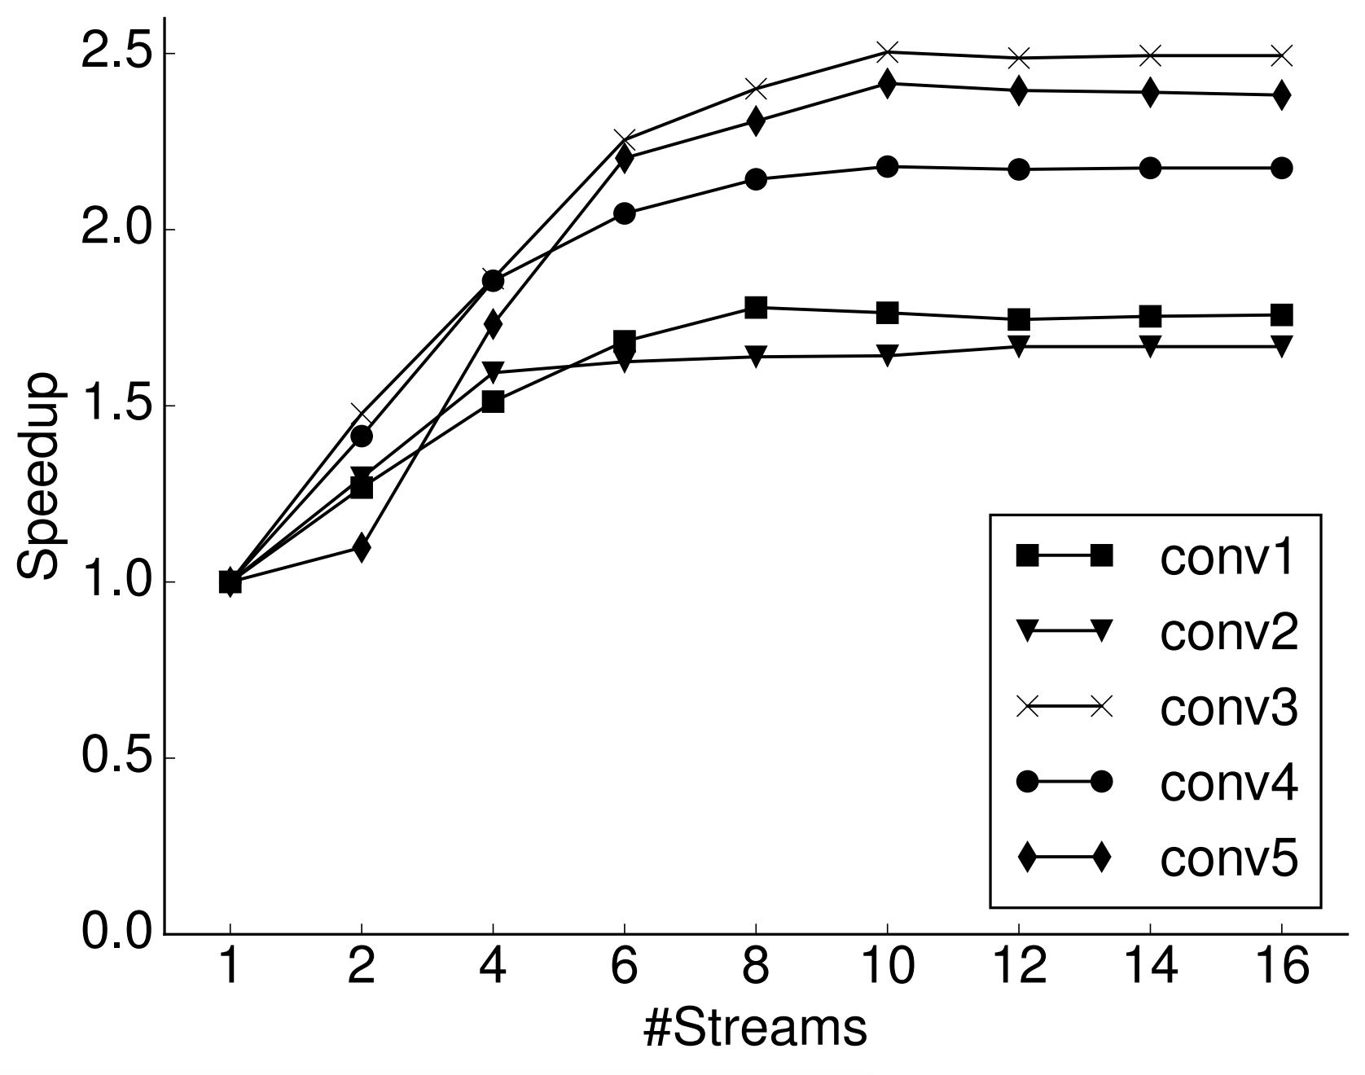
Overview -- Motivation
Modern GPUs support concurrent kernel executions.
The training of a DNN model can be accelerated by utilizing concurrent kernel execution strategy.
the kernel execution can be overlapped when utilizing concurrent streams.
different speedup can be obtained when exploiting different number of concurrent streams.
Notes:
During the past years, the computation capability of GPUs has been improved a lot, and most modern GPUs are designed with the support of concurrent kernel execution.
Matrix-matrix or matrix-vector operations are the basic component in most deep neural network applications, but the computation workload of a single operation cannot fully utilize the GPU resources, which may lead to resource underutilization and introduce new spaces for further accelerations by utilizing emerging hardware features.
In order to find out whether concurrent kernel execution can help accelerate the computation of a DNN models, we conduct several experiments by utilizing different streams. From the left figure, we can see that the computation of training a neural network can be accelerated by utilizing multiple streams. And the right figure shows that the computation of kernels from a single convolution layer can be ovelapped with two streams and can be completed in a shorter time.

Slide 5
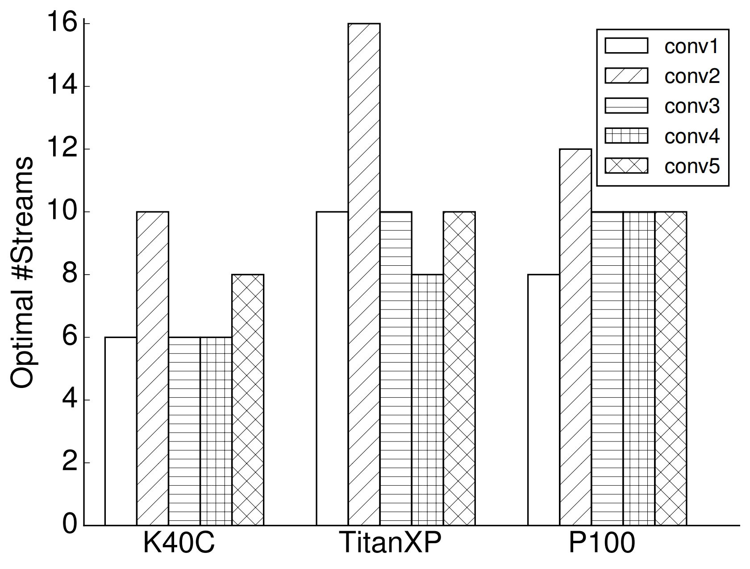
Overview -- Motivation
The optimal number of concurrent kernels varies from GPU to GPU
More streams may consume more hardware resources.
Notes:
Now we have seen that concurrent streams can be used to accelerate the computation of a neural network. Next, we try to figure out that whether a best speedup can be found with a fixed number of streams for a specific convolutional layer. This figure shows that the optimal number of CUDA streams based on the runtime for convolution layers from CaffeNet model may differ from device to device. Although we can just exploit all available CUDA streams supported by a specific device, it may have several disadvantages. First, we cannot get more performance improvement with more CUDA streams, on the contrary, it may incur a small performance degradation. Second, it may consume too many GPU stream resources. Third, the maximum number of streams supported by GPUs also varies from device to device.

Slide 6
Overview -- Objectives
Design a convergence-invariant and network-agnostic light-weight parallelization framework
Launch proper number of kernels concurrently based on kernel configurations and the device property
Avoid occupying too many CPU threads or processes and GPU stream resources
Notes:
Hence, the main objective of our work is to design a convergence-invariant and network-agnostic light-weight parallelization framework for DNNs on modern GPUs. It should figure out a propoer number of concurrent kernels based on kernel execution configurations and the device property. And it should avoid occupying too many CPU resources and GPU stream resources.

Slide 7
Overview – Technical Challenges
How to collect kernel execution configurations on-the-fly
Conventional profiling tools are utilized in an offline manner, and a sample execution is required
How to determine the number of concurrent kernels on a specific device
The number of concurrent kernels should be adjusted based on the workload and the device property
How to guarantee the convergence property of neural networks
A parameter tuning process is always conducted to ensure appropriate convergence property, and it is important to retain the effect of this process
Notes:
There are three challenges to be addressed. The first one is how to collect kernel execution configurations on-the-fly. Traditional profiling tools like nvprof and Visual Profiler work in an offline manner, and a sample execution is often required. The second one is how to determine the number of concurrent kernels on a specific devie. It should be adjusted according to workloads and GPU devices. The last one is how to guarantee the convergence property of neural networks. Since a parameter tuning process is always conducted to ensure appropriate convergence property, and it is important to retain the effect of this process.

Slide 8
Overview -- Related Works
Most existing frameworks mainly focus on the usability and scalability.
Caffe^{[MM'14]}: use concurrent kernel execution in the channel level
TensorFlow^{[OSDI'16]} and MXNet^{[arXiv'15]}: use CUDA streams for overlapping computation and data transfer
PyTorch: provide a low-level stream API which can be controlled by users
Optimizations for a single kernel on GPU devices:
(1) reducing arithmetic complexity in convolution layers^{[CVPR'16, arXiv'14]},
(2) optimizing memory layout^{[SC'16]}
Coarse Grain Parallelization of DNNs^{[PPoPP'16]} is the most similar work to ours, but it tend to exploit multi-thread technique to accelerate the training of DNNs and the number of threads should be determined by users.
Notes:
Various works have been done to accelerate the computation of neural networks on GPUs. For example, many frameworks were released for DL applications. But to our knowledge, most of them mainly focus on the usability and scalability. And the performance on a single GPU is largely overlooked. There are some other optimizations on reducing arithmetic complexity in convolution layers and memory accesses. The work published on PPoPP 2016 conference is the most similar work to ours. But it tend to exploit multi-thread technique to accelerate the training of DNNs, in which the number of threads must be determined by users.

Slide 9
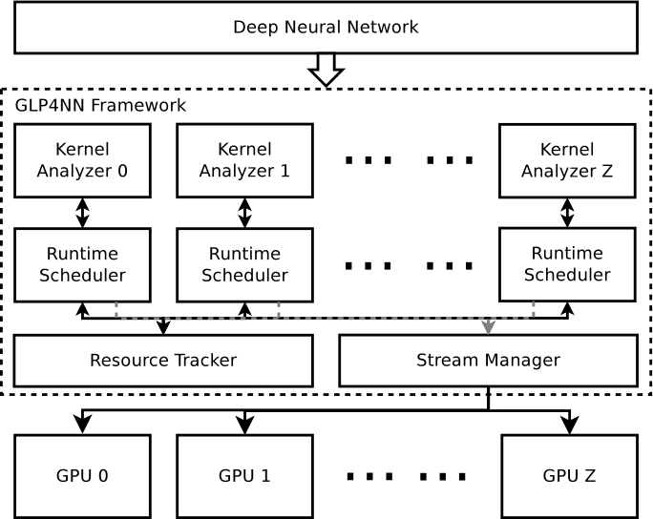
Our Solution: GLP4NN
Kernel Analyzer: analyzes kernel configurations collected and calculate the number of concurrent kernels based on the device property
Runtime Scheduler: schedules the execution of kernels
Resource Tracker: collects kernel execution configurations
Stream Manager: manages the CUDA streams created
Notes:
In this paper, we present a light-weight parallelization framework called GLP4NN. It consists of four components. The kernel analyzer is responsible for analyzing kernel configurations collected and calculate the number of concurrent kernels based on the device property. And the runtime scheduler is designed to handle kernel launching. To gather kernel execution configuraitons on the fly and manages the concurrent CUDA streams, we develop a light-weight resource tracker and a pool-style stream manager in this framework.

Slide 10
Our Solution -- Kernel Analyzer
Kernel Analyzer
determines the number of concurrent kernels that can be launched in parallel
analytical model --> maximizing the occupancy ratio of a GPU device
soft constraints & hard constraints
Notes:
In the kernel analyzer, we propose an analytical model to get the proper numbrer of concurrent kernels by maximizing the occupancy ratio of a GPU device. While considering kernel execution configurations, some kinds of resources are more important than others, so we categorized them into soft constraints and hard constraints. And in this paper, we only consider the hard constraints.
which is defined as the ratio of active warps on a SM to the maximum number of active warps supported by a SM

Slide 11
Our Solution -- Resource Tracker
Resource Tracker
collects kernel execution configurations with low overhead on-the-fly
parses these information collected for further processing
avoids collecting trivial kernel runtime information
launched only once for a neural network model on a specific device
kernel name
kernel runtime configuration
Notes:
The resource tracker is design for collecting kernel configurations and preprocessing these information. To avoid the collection of trivial kernel runtime information, we design a compact kernel profiler based on the CUPTI library and only call this profiler once for a neural network mdoel on a specific device. Typical configurations after preprocessing can be found in this figure.

Slide 12
Our Solution -- Stream Manager
manage the CUDA streams created for concurrent kernel execution
supports synchronizing operations between streams
kernel
thread
stream
kernel
1
1
1
GPU
1
scheduler
stream
pool
GPU
2
2
2
2
...
1
n
3
3
3
3
4
4
4
4
Solution with multiple threads
our solution
Notes:
To manage the CUDA streams created for concurrent kernel execution, a common approach is to make use of multiple CPU threads, which is assinged with a default CUDA stream by default. But this may consume many thread resources. So we tend to design a pool-style stream manager for concurrent kernel execution. A default stream per device is also included to do synchronization operations.

Slide 13
Our Solution -- Overhead Analysis
Time analysis: including the profiling time, kernel analysis time and the scheduling time
Space analysis: all memory required is allocated in the host memory and can be safely released after the kernel analysis phase
Notes:
As we aim at designing a light-weight parallelization framework, we also present the overhead analysis for this framework. It can be divided into the time analysis and space analysis. For the time analysis, it mainly includes the profiling time, kernel analysis time and scheduling time. In the current impelmentation, we adopted a simple round-robin scheduling algorithm, so the scheduling time can be safely ignored in this paper. For the space analysis, there are three kinds of memory allocated. But all of them are located in the host memory, they can be safely released after the kernel analysis.

Slide 14
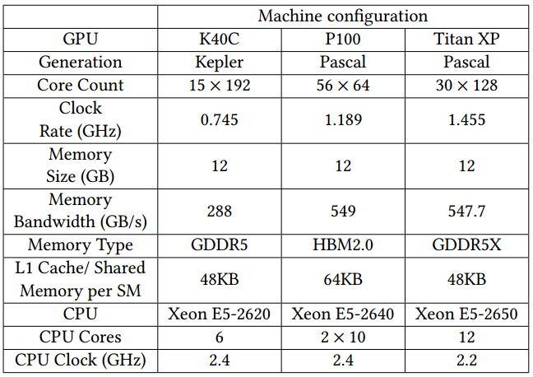
Evaluation -- Experiment Setup
software
Caffe Framework^{[MM'14]}
CUDA toolkit 8.0
glpk-4.63
Datasets and models
MNIST^{[Proc. of IEEE'98]} -- siamese model
CIFAR-10^{[Tech. Report'09]} -- CIFAR10 model
ImageNet 2012^{[IJCV'12]} -- CaffeNet model & GoogLeNet
Notes:
To validate the perfomance of the proposed framework, we have conducted several experiments on it. The experiment setup is shown as follows. Three different GPUs from NVIDIA are adopted and we provide an implementation based on the Caffe framework, which is one of the popular framework in computer vision. We train four neural network models on the MNIST, CIFAR-10 and ImangeNet 2012 datasets. The overall performance can be seen as follows.

Slide 15
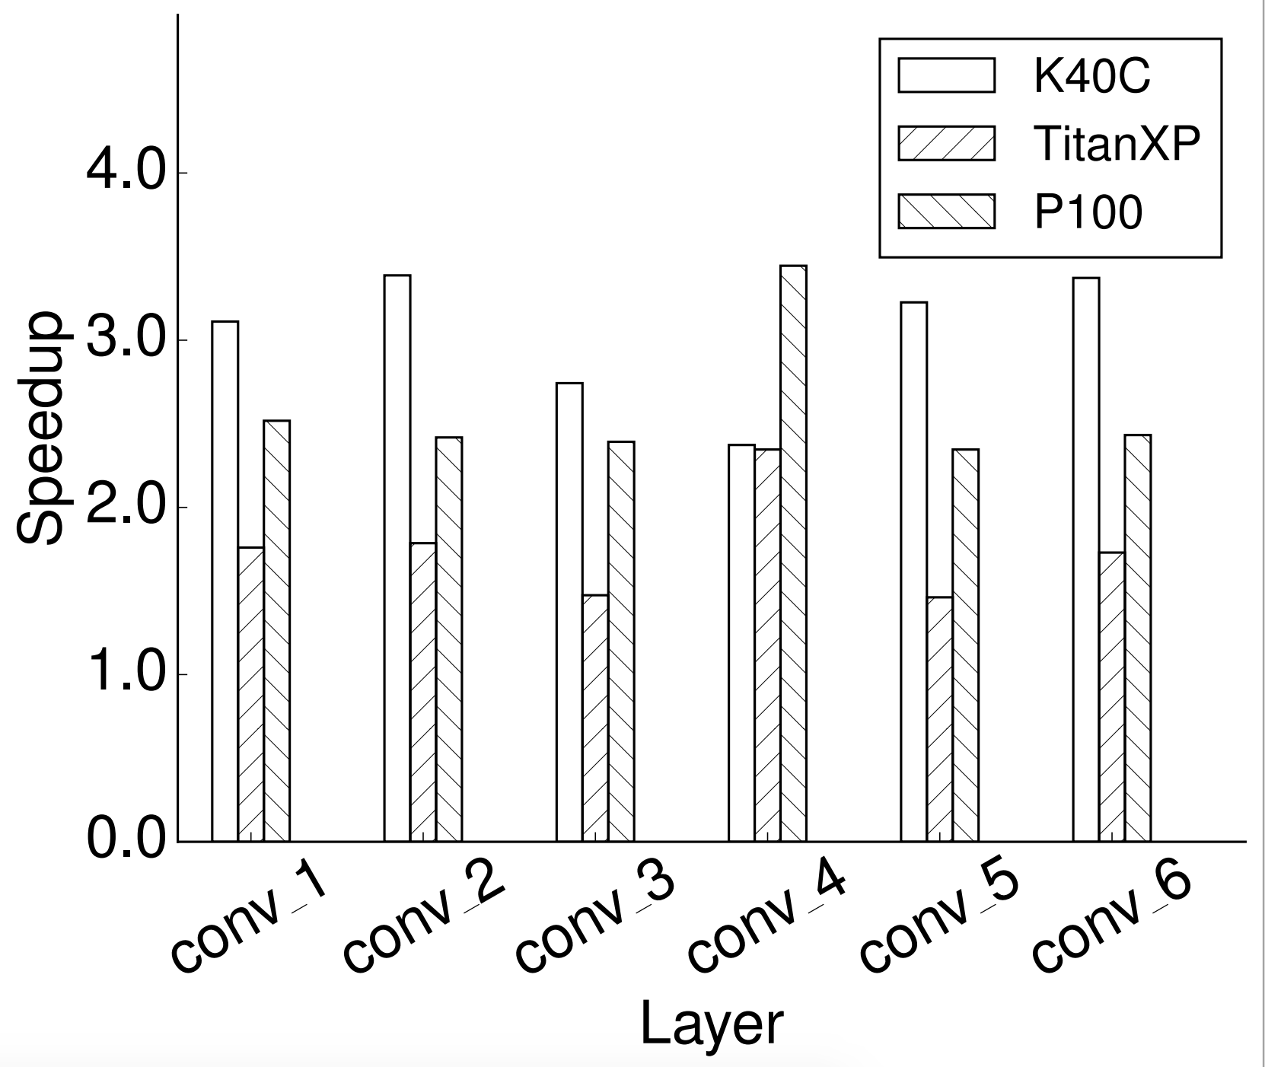
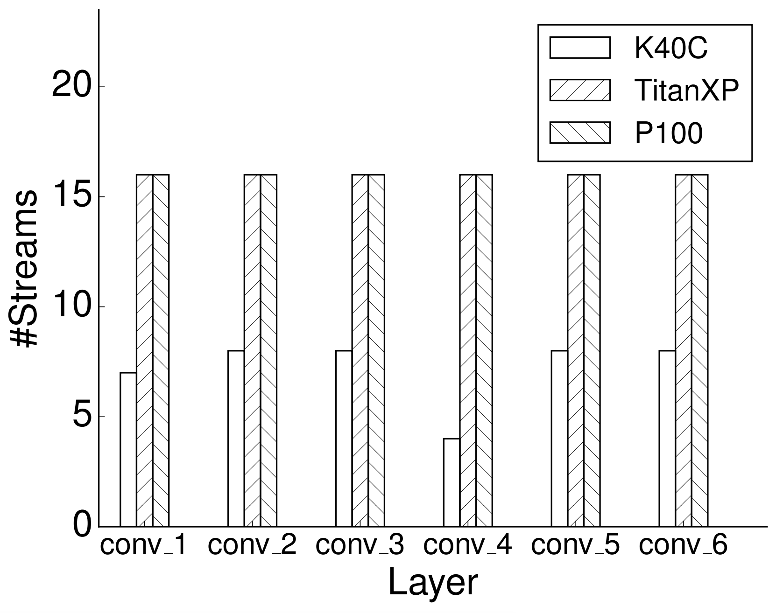
Evaluation -- Speedup
Number of concurrent kernels launched for these layers
Speedup of GLP4NN-Caffe over Caffe for convolution layers of GoogLeNet
Notes:
Fig. 7 is speedup results of the four models on GPUs. There are 59 convolution layers in GoogLeNet mdoel and we only select 6 out of them for clarity. It can be seen that with GLP4NN, we can obtain a speedup ratio up to near 3.5. And Fig. 8 shows the output on the number of concurrent kernels of the proposed analytical model. We can see that it is more easy to get a high number of kernels to run concurrently on new-generation GPUs.

Slide 16
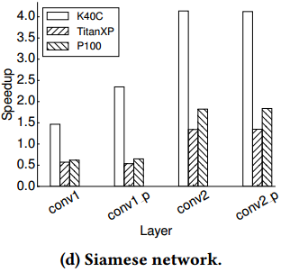
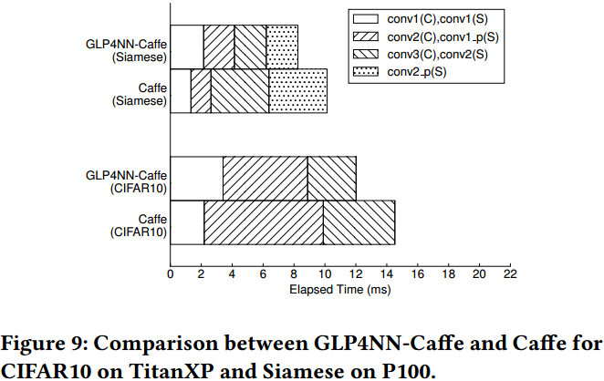
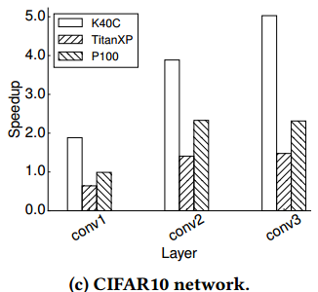
Evaluation -- Speedup (2)
comparison between GLP4NN-Caffe and Caffe for CIFAR10 on TitanXP and Siamese on P100
Notes:
In Fig. 7, we also find that the proposed framework may obtain a

Slide 17
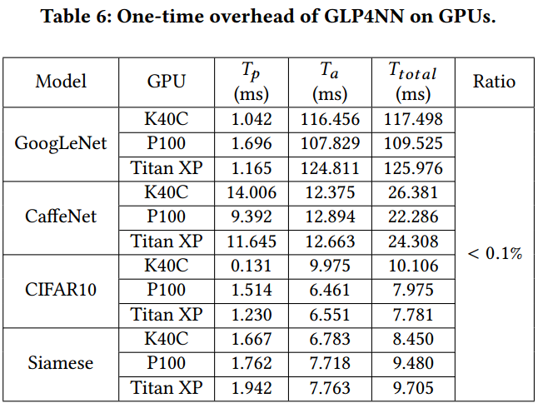
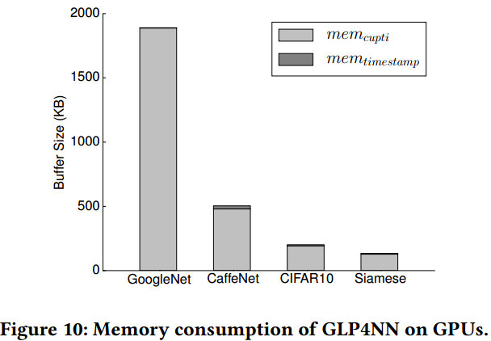
Evaluation -- Overhead Analysis
space analysis
time analysis

Slide 18
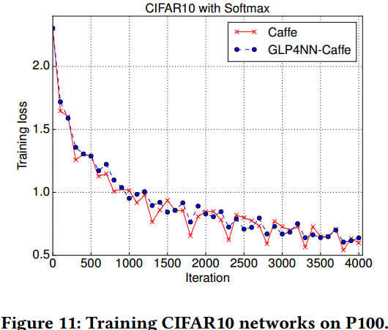
Evaluation -- Convergence Validation
The difference between GLP4NN-Caffe and Caffe is caused by the shuffle process while fetching training batch samples.
Training CIFAR10 networks on P100

Slide 19
Conclusions
GLP4NN is a light-weight parallelization framework for DNN models without affecting their convergence property.
It can collect kernel execution configurations on-the-fly with a low overhead.
It can support concurrent kernel execution without consuming too many host threads by utilizing a pool-style stream manager.
Experiment results indicate that GLP4NN can efficiently accelerate the training of a DNN model on modern GPUs.

Slide 20
Acknowledgements
The work was partially done when Hao Fu is a visiting student to National University of Singapore supported by the China Scholarship Council (NO. 201706250162).
This work is supported by the National Natural Science Foundation of China (61602336, 11573019), the Joint Research Fund in Astronomy (U1731423, U1531111) and a MoE AcRF Tier 2 grant (MOE2017-T2-1-122) in Singapore.
Thanks for the hardware donation from NVIDIA Corporation.

Slide 21
Q & A Thank you!

